Slide 1
The Greedy Approach
Young
CS 331 D&A of Algo.
Greedy

Slide 2
General idea:
Given a problem with n inputs, we are required to obtain a subset that maximizes or minimizes a given objective function subject to some constraints.
Feasible solution — any subset that satisfies some constraints
Optimal solution — a feasible solution that maximizes or minimizes the objective function
Young
CS 331 D&A of Algo.
Greedy

Slide 3
procedure Greedy (A, n)
begin
solution ← Ø;
for i ← 1 to n do
x ← Select (A); // based on the objective // function
if Feasible (solution, x),
then solution ← Union (solution, x);
end;
Select: A greedy procedure, based on a given objective function, which selects input from A, removes it and assigns its value to x.
Feasible: A boolean function to decide if x can be included into solution vector (without violating any given constraint).
Young
CS 331 D&A of Algo.
Greedy

Slide 4
About Greedy method
The n inputs are ordered by some selection procedure which is based on some optimization measures.
It works in stages, considering one input at a time. At each stage, a decision is made regarding whether or not a particular input is in an optimal solution.
Young
CS 331 D&A of Algo.
Greedy

Slide 5
Minimum Spanning Tree ( For Undirected Graph)
The problem:
    Tree
      A Tree is connected graph with no cycles.
    Spanning Tree
      A Spanning Tree of G is a tree which contains all vertices
      in G.
      Example:
      G:
Young
CS 331 D&A of Algo.
Greedy

Slide 6
    Is G a Spanning Tree?
Key: Yes Key: No
Note: Connected graph with n vertices and exactly n – 1 edges is Spanning Tree.
  Minimum Spanning Tree
Assign weight to each edge of G, then Minimum Spanning Tree is the Spanning Tree with minimum total weight.
Young
CS 331 D&A of Algo.
Greedy

Slide 7
  Example:
    Edges have the same weight
    G:
1
2
3
6
7
4
5
8
Young
CS 331 D&A of Algo.
Greedy

Slide 8
    DFS (Depth First Search)
1
7
2
3
5
4
6
8
Young
CS 331 D&A of Algo.
Greedy

Slide 9
  BFS (Breadth First Search)
1
2
3
4
5
6
7
8
Young
CS 331 D&A of Algo.
Greedy

Slide 10
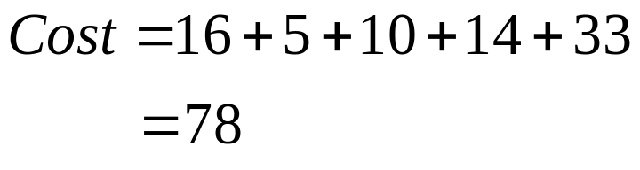
Edges have different weights
G:
  DFS
16
1
2
21
11
5
6
3
19
6
33
14
4
10
5
18
16
1
2
5
6
33
3
14
4
10
5
Young
CS 331 D&A of Algo.
Greedy

Slide 11
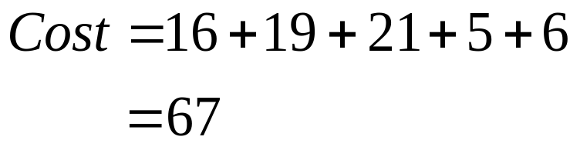
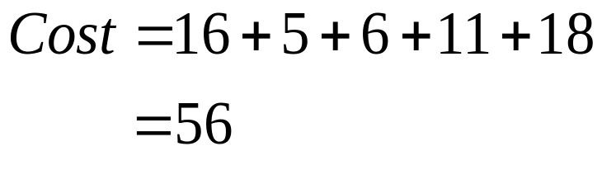
    BFS
     Minimum Spanning Tree (with the least total weight)
16
5
1
2
3
21
6
19
6
4
5
16
1
2
5
11
6
3
6
18
4
5
Young
CS 331 D&A of Algo.
Greedy

Slide 12
Algorithms:
  Prim’s Algorithm (Minimum Spanning Tree)
  Basic idea:
  Start from vertex 1 and let T ← Ø (T will contain all edges in the S.T.); the next edge to be included in T is the minimum cost edge(u, v), s.t. u is in the tree and v is not.
  Example: G
16
1
2
21
11
5
6
3
19
6
33
14
4
10
5
18
Young
CS 331 D&A of Algo.
Greedy

Slide 13
1
1
2
16
19
19
21
21
5
11
6
2
5
6
5
6
3
6
4
(Spanning Tree)
S.T.
S.T.
1
2
1
1
2
3
1
2
3
4
19
21
19
21
11
18
14
6
11
10
5
6
6
4
5
6
6
5
6
4
S.T.
1
2
3
1
2
3
S.T.
4
Young
CS 331 D&A of Algo.
Greedy

Slide 14
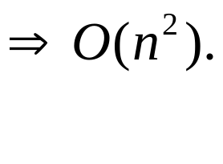
1
2
3
4
6
S.T.
1
2
3
19
18
33
4
6
5
5
5
5
Cost = 16+5+6+11+18=56
Minimum Spanning Tree
1
2
3
S.T.
4
6
(n – # of vertices, e – # of edges)
It takes O(n) steps. Each step takes O(e) and e ≤ n(n-1)/2
Therefore, it takes O(n³) time.
With clever data structure, it can be implemented in O(n²).
Young
CS 331 D&A of Algo.
Greedy

Slide 15
Example:
Step 1: Sort all of edges
(1,2) 10 √
(3,6) 15 √
(4,6) 20 √
(2,6) 25 √
(1,4) 30 × reject create cycle
(3,5) 35 √
Kruskal’s Algorithm
Basic idea:
Don’t care if T is a tree or not in the intermediate stage, as long as the including of a new edge will not create a cycle, we include the minimum cost edge
10
30
1
2
50
25
4
45
3
40
20
35
6
5
55
15
Young
CS 331 D&A of Algo.
Greedy

Slide 16
Step 2: T
1
2
1
2
3
6
1
2
3
6
4
1
2
3
6
4
1
2
3
6
4
5
Young
CS 331 D&A of Algo.
Greedy

Slide 17
How to check:
adding an edge will create a cycle or not?
If Maintain a set for each group
(initially each node represents a set)
Ex: set1 set2 set3
∴ new edge
from different groups ⇒ no cycle created
Data structure to store sets so that:
    The group number can be easily found, and
    Two sets can be easily merged
1
2
3
6
4
5
2
6
Young
CS 331 D&A of Algo.
Greedy

Slide 18
Kruskal’s algorithm
While (T contains fewer than n-1 edges) and (E ≠ ∅ ) do
Begin
Choose an edge (v,w) from E of lowest cost;
Delete (v,w) from E;
If (v,w) does not create a cycle in T
then add (v,w) to T
else discard (v,w);
End;
With clever data structure, it can be implemented in O(e log e).
Young
CS 331 D&A of Algo.
Greedy

Slide 19
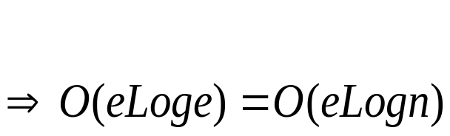

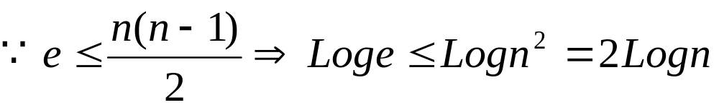
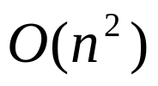

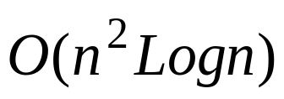
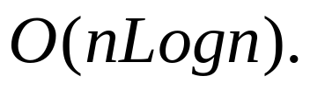
So, complexity of Kruskal is
Comparing Prim’s Algorithm with Kruskal’s Algorithm
  Prim’s complexity is
  Kruskal’s complexity is
    if G is a complete (dense) graph,
    Kruskal’s complexity is .
    if G is a sparse graph,
    Kruskal’s complexity is
Young
CS 331 D&A of Algo.
Greedy

Slide 20
Dijkstra’s Algorithm for Single-Source Shortest Paths
The problem: Given directed graph G = (V, E),
a weight for each edge in G,
a source node v₀,
Goal: determine the (length of) shortest paths from v₀ to all the remaining vertices in G
Def: Length of the path: Sum of the weight of the edges
Observation:
May have more than 1 paths between w and x (y and z)
But each individual path must be minimal length
(in order to form an overall shortest path form v₀ to v_{i} )
w x y z
V₀
shortest paths from v₀ to v_{i}
V_{i}
Young
CS 331 D&A of Algo.
Greedy

Slide 21


Notation
cost adjacency matrix Cost, ∀1 ≤ a,b ≤ ⏐V⏐
Cost (a, b) =
cost from vertex i to vertex j if there is a edge
0 if a = b
otherwise
1 if shortest path (v₀ , w) is defined
0 otherwise
s(w) =
in the vertex set V
= the length of the shortest path from v₀ to j
if i is the predecessor of j along the shortest
path from v₀ to j
Young
CS 331 D&A of Algo.
Greedy

Slide 22
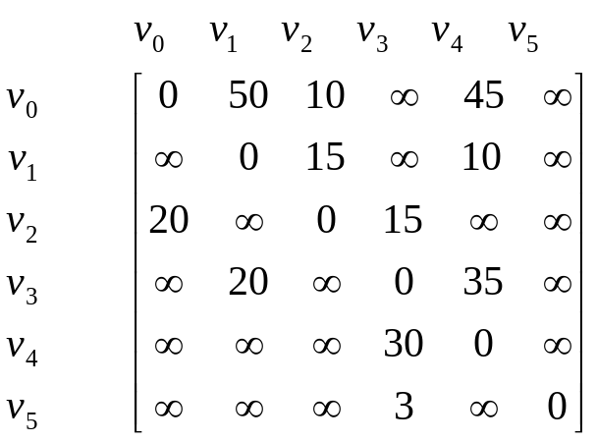
45
Example:
50
10
V₀
V₁
V₄
15
35
10
20
20
30
V₂
V₃
V₅
15
3
Cost adjacent matrix
Young
CS 331 D&A of Algo.
Greedy

Slide 23
Steps in Dijkstra’s Algorithm
1. Dist (v₀) = 0, From (v₀) = v₀ 2. Dist (v₂) = 10, From (v₂) = v₀
45
45
50
10
50
10
V₄
V₀
V₁
V₄
V₀
V₁
15
15
35
10
20
10
35
20
20
20
30
30
V₂
V₃
V₅
V₂
V₃
V₅
15
3
15
3
Young
CS 331 D&A of Algo.
Greedy

Slide 24
3. Dist (v₃) = 25, From (v₃) = v₂ 4. Dist (v₁) = 45, From (v₁) = v₃
45
45
V₀
50
V₁
10
50
10
V₄
V₀
V₁
V₄
15
35
15
20
10
35
20
10
20
20
30
30
V₂
V₃
V₅
V₂
V₃
V₅
15
3
15
3
Young
CS 331 D&A of Algo.
Greedy

Slide 25
5. Dist (v₄) = 45, From (v₄) = v₀ 6. Dist (5) = ∞
45
45
50
10
50
10
V₀
V₁
V₄
V₀
V₁
V₄
15
15
35
35
20
10
20
10
20
20
30
30
V₂
V₃
V₅
V₂
V₃
V₅
15
3
15
3
Young
CS 331 D&A of Algo.
Greedy

Slide 26
Shortest paths from source v₀
v₀ → v₂ → v₃ → v₁ 45
v₀ → v₂ 10
v₀ → v₂ → v₃ 25
v₀ → v₄ 45
v₀ → v₅ ∞
Young
CS 331 D&A of Algo.
Greedy

Slide 27
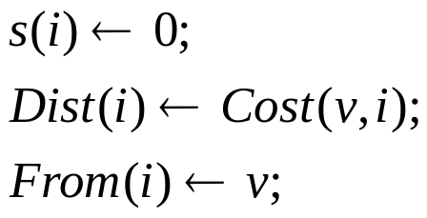


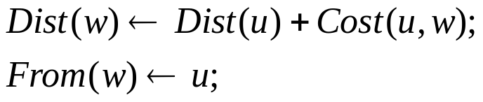
Dijkstra’s algorithm:
procedure Dijkstra (Cost, n, v, Dist, From)
// Cost, n, v are input, Dist, From are output
begin
for i ← 1 to n do
for num ← 1 to (n – 1) do
choose u s.t. s(u) = 0 and Dist(u) is minimum;
for all w with s(w) = 0 do
if
end;
(cont. next page)
Young
CS 331 D&A of Algo.
Greedy

Slide 28
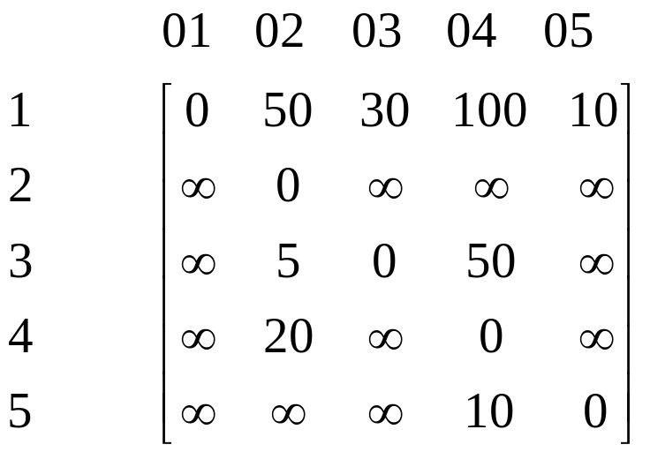
Ex:
1
10
50
100
30
5
2
20
10
5
4
3
50
Cost adjacent matrix
Young
CS 331 D&A of Algo.
Greedy

Slide 29
Steps in Dijkstra’s algorithm
1. Dist (1) = 0, From (1) = 1 2. Dist (5) = 10, From (5) = 1
1
1
10
50
10
50
100
30
30
5
2
5
100
2
20
20
10
5
10
5
4
3
4
3
50
50
Young
CS 331 D&A of Algo.
Greedy

Slide 30
3. Dist (4) = 20, From (4) = 5 4. Dist (3) = 30, From (3) = 1
1
1
10
50
10
50
100
30
100
30
5
2
5
2
20
20
10
5
10
5
4
3
4
3
50
50
5. Dist (2) = 35, From (2) = 3
Shortest paths
from source 1
1 → 3 → 2 35
1 → 3 30
1 → 5→ 4 20
1 → 5 10
1
10
50
100
30
5
2
20
10
5
Young
CS 331 D&A of Algo.
Greedy
4
3
50

Slide 31
Optimal Storage on Tapes
The problem:
Given n programs to be stored on tape, the lengths of
these n programs are l₁, l₂ , . . . , l_{n} respectively.
Suppose the programs are stored in the order
of i₁, i₂ , . . . , i_{n}
Let t_{j} be the time to retrieve program i_{j}.
Assume that the tape is initially positioned at the beginning.
t_{j} is proportional to the sum of all lengths of programs stored in front of the program i_{j}.
Young
CS 331 D&A of Algo.
Greedy

Slide 32
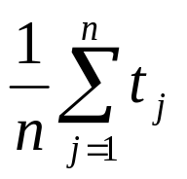
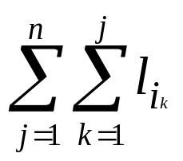
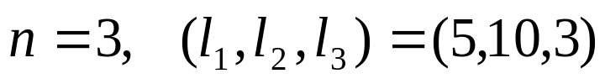
The goal is to minimize MRT (Mean Retrieval Time),
i.e. want to minimize
Ex:
There are n! = 6 possible orderings for storing them.
order
total retrieval time
MRT
1
2
3
4
5
6
1 2 3
1 3 2
2 1 3
2 3 1
3 1 2
3 2 1
5+(5+10)+(5+10+3)=38
5+(5+3)+(5+3+10)=31
10+(10+5)+(10+5+3)=43
10+(10+3)+(10+3+5)=41
3+(3+5)+(3+5+10)=29
3+(3+10)+(3+10+5)=34
38/3
31/3
43/3
41/3
29/3
34/3
Smallest
Note: The problem can be solved using greedy strategy,
just always let the shortest program goes first.
( Can simply get the right order by using any sorting algorithm)
Young
CS 331 D&A of Algo.
Greedy

Slide 33
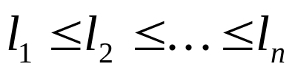
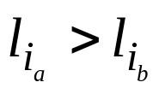
Analysis:
Try all combination: O( n! )
Shortest-length-First Greedy method: O (nlogn)
Shortest-length-First Greedy method:
Sort the programs s.t.
and call this ordering L.
Next is to show that the ordering L is the best
Proof by contradiction:
Suppose Greedy ordering L is not optimal, then there exists some other permutation I that is optimal.
I = (i₁, i₂, … i_{n}) ∃ a < b, s.t. (otherwise I = L)
Young
CS 331 D&A of Algo.
Greedy

Slide 34
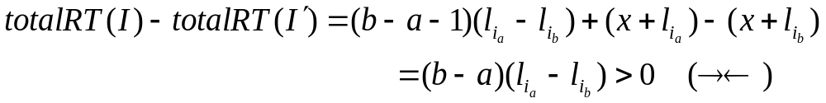
Interchange i_{a} and i_{b} in and call the new list I′ :
I
I′
x
…
i_{a}
i_{a+1}
i_{a+2}
…
i_{b}
…
SWAP
…
i_{b}
i_{a+1}
i_{a+2}
…
i_{a}
…
x
In I′, Program i_{a+1} will take less (l_{ia}- l_{ib}) time than in I to be retrieved
In fact, each program i_{a+1} , …, i_{b-1} will take less (l_{ia}- l_{ib}) time
For i_{b}, the retrieval time decreases x + l_{ia}
For i_{a}, the retrieval time increases x + l_{ib}
Contradiction!!
Therefore, greedy ordering L is optimal
Young
CS 331 D&A of Algo.
Greedy

Slide 35
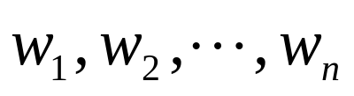
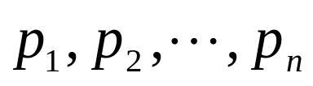

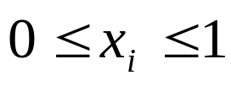
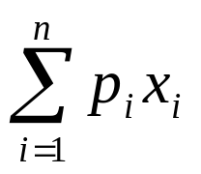
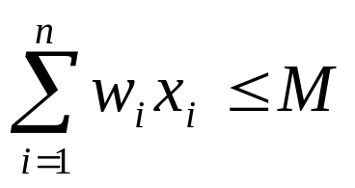
Knapsack Problem
The problem:
Given a knapsack with a certain capacity M,
n objects, are to be put into the knapsack,
each has a weight and
a profit if put in the knapsack .
The goal is find where
s.t. is maximized and
Note: All objects can break into small pieces
or x_{i} can be any fraction between 0 and 1.
Young
CS 331 D&A of Algo.
Greedy

Slide 36
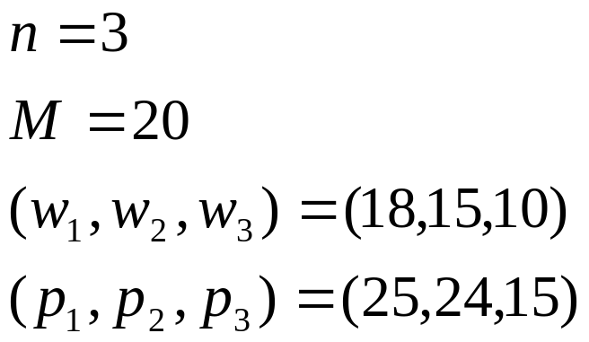
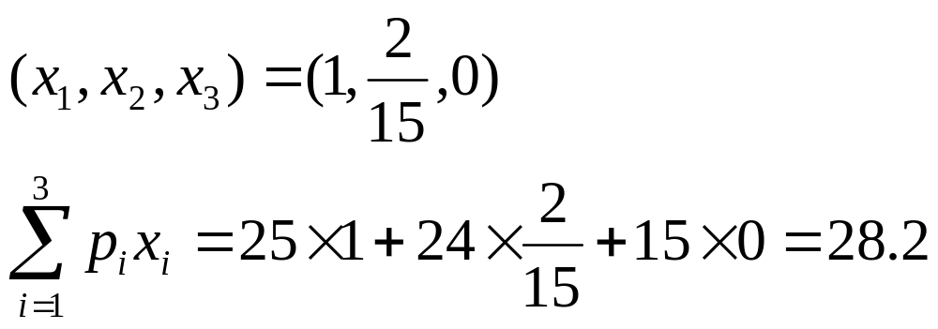
Example:
Greedy Strategy#1: Profits are ordered in nonincreasing order (1,2,3)
Young
CS 331 D&A of Algo.
Greedy

Slide 37
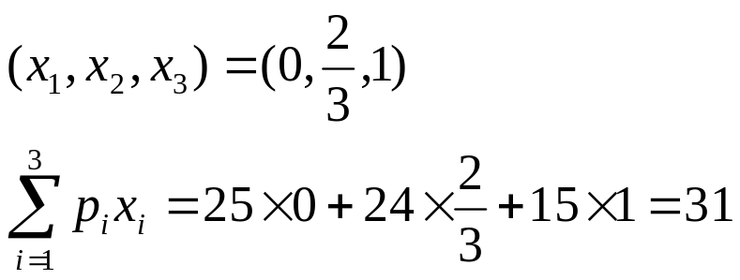
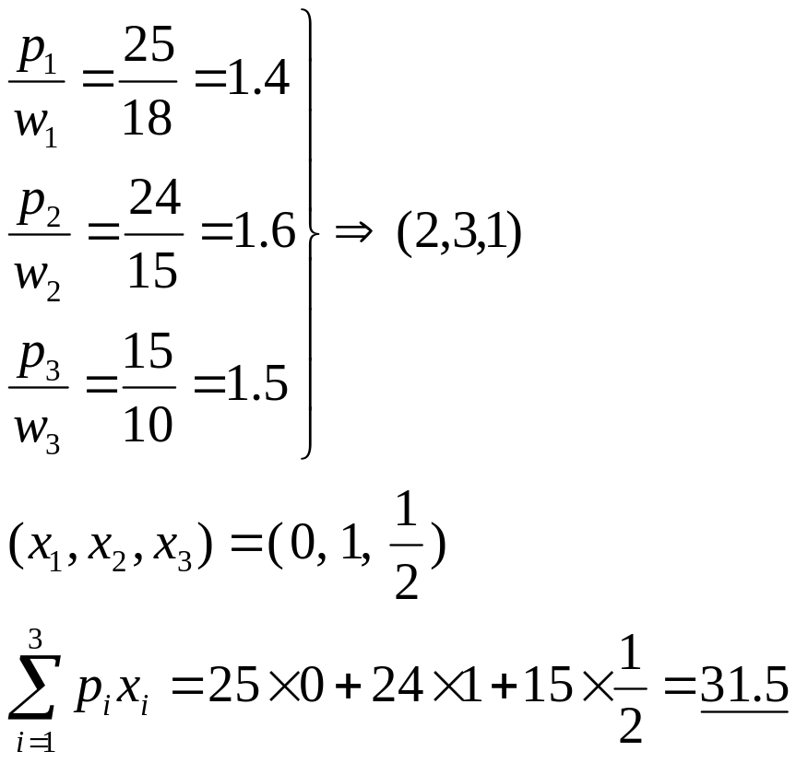
Greedy Strategy#2: Weights are ordered in nondecreasing order (3,2,1)
Greedy Strategy#3: p/w are ordered in nonincreasing order (2,3,1)
Optimal solution
Young
CS 331 D&A of Algo.
Greedy

Slide 38
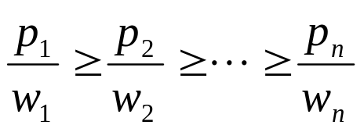
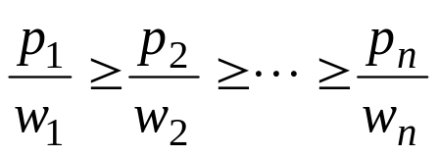


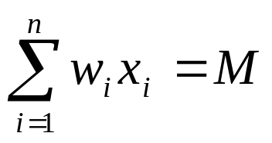
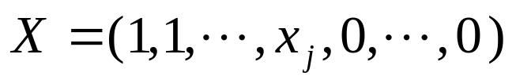
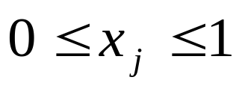
Analysis:
Sort the p/w, such that
Show that the ordering is the best.
Proof by contradiction:
Given some knapsack instance
Suppose the objects are ordered s.t.
let the greedy solution be
Show that this ordering is optimal
Case1: it’s optimal
Case2: s.t.
where
Young
CS 331 D&A of Algo.
Greedy

Slide 39

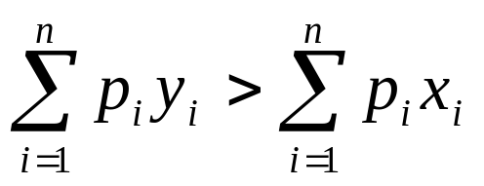
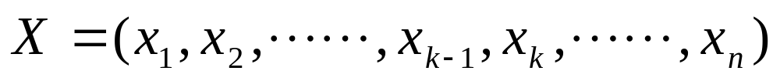
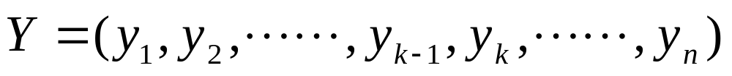
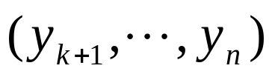
Assume X is not optimal, and then there exists
s.t. and Y is optimal
examine X and Y, let y_{k} be the 1st one in Y that y_{k} ≠ x_{k}.
y_{k} ≠ x_{k} ⇒ y_{k} < x_{k}
same
Now we increase y_{k} to x_{k} and decrease as many of
as necessary, so that the capacity is still M.
Young
CS 331 D&A of Algo.
Greedy

Slide 40
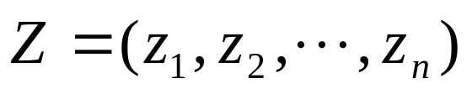
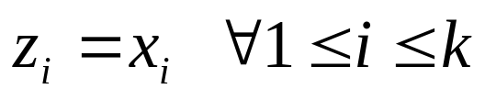
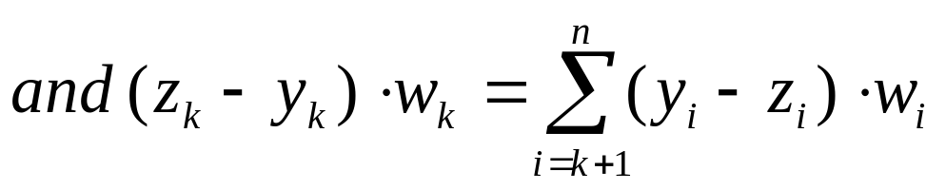
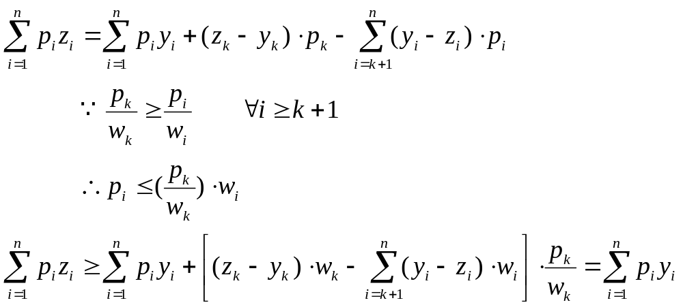
Let this new solution be
where
0
Young
CS 331 D&A of Algo.
Greedy

Slide 41
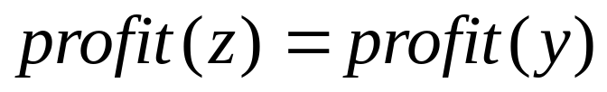

So,
if
else
(Repeat the same process.
At the end, Y can be transformed into X.
⇒ X is also optimal.
Contradiction! )
Young
CS 331 D&A of Algo.
Greedy

